Slide 1
Attack Surface Reductions for the Adventurous Admin
Mathias R. Jessen
@IISResetMe
Notes:
This is the slide shown before the presentation starts. When you are ready to go, tell the video operator to start the recording, and click to the next slide.

Slide 2
5
Video operator, did you start the recording?
Notes:
[REQUIRED SLIDE]
These slides are mandatory and help us with video post-processing. Please keep them as they are.

Slide 3
4
Notes:
[REQUIRED SLIDE]

Slide 4
3
Notes:
[REQUIRED SLIDE]

Slide 5
2
Notes:
[REQUIRED SLIDE]

Slide 6
1
Notes:
[REQUIRED SLIDE]

Slide 7
Attack Surface Reductions for the Adventurous Admin
Mathias R. Jessen
@IISResetMe
Notes:
This is your opening. Now the stage is yours!

Slide 8
How to insert your Twitter handle
1. On the Insert tab, select Header & Footer.
2. On the Slide tab, check the Footer box.
3. In the box below Footer, type your Twitter handle (e.g. @PSConfEU).
4. To prevent the footer from appearing on the title slide, check the Don't show on title slide box.
5. Click Apply to All button.

Slide 9
This Session
We‘ll talk about Windows Security
Pragmatic Security Engineering
Notes:
Please invest some time to reconsider your session: what is it that audience can get out of it? Try and be as precise as you can. If you are showing solutions, then focus on “how to”. If you present about a general technology, you’ll want to stick to “Be able to” or “Understand why/how”.

Slide 10
Agenda
Where I‘m coming from
Principles of Pragmatic Security Engineering
What brings down enterprises and what you can do
Case studies
L.A.T.E.R – Local Admin Temporary Elevation Request
NoMoreNeedToCry – Ransomware mitigation at no cost
Summary
Notes:
Psconf.eu is about demos and code. Try and minimize use of text slides

Slide 11
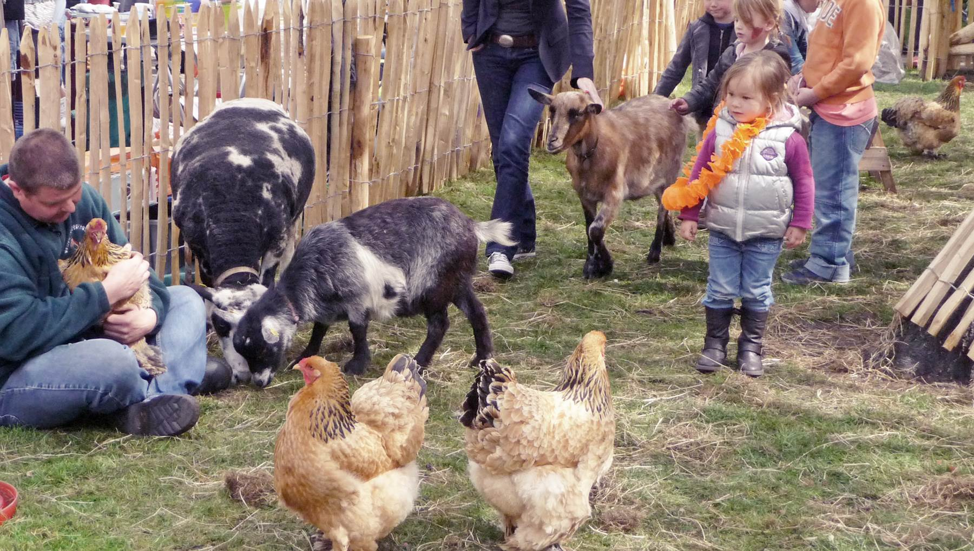
Where I‘m coming from
Notes:
We all know the “Pet Shop <-> Cattle Farm” dichotomy. Traditionally sysadmins would assign “cute” names to app servers and implicitly attach emotional value to them. This is bad.
I started out in what I like to describe as a “Petting Zoo” - doing escalation support at a hosting provider for hundreds of business customers with anywhere from 5 to 600.000 employees – I saw a lot of pets but also a lot of corporations starting to approach cattle farming out of necessity.

Slide 12
Principles of Pragmatic Security Engineering
Engage with empathy
Transition from disabler -> enabler
Re-focus on understanding systems, risk and opportunity
Notes:
Pragmatic Security Engineering is not a well-founded philosophy, but simply my own non-technical rules that I remind myself of when working on new problems and solutions

Slide 13
Enagage with empathy
Get comfortable talking to your customers/users
Notes:
IT traditionally has attracted an overrepresentation of people more comfortable working with machines than people – time to step out of that comfort zone if you want to get anything done.

Slide 14
Enagage with empathy
What is their mission?
How do they seek to achieve it?
Why?
Notes:
How can you help solve problems you don’t understand the context of?

Slide 15
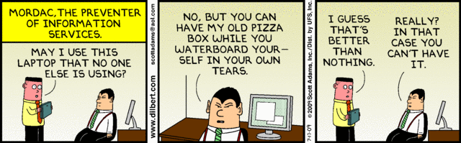
Transition to enablement
Please treat this as yesterday’s mentality

Slide 16
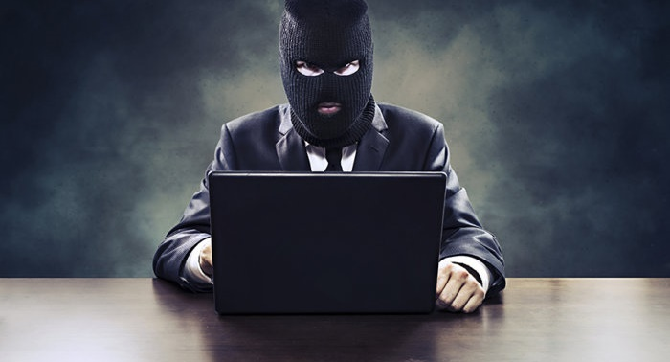
Transition to enablement
Yesterday’s mentality
Here’s what we can do
No!
No!
Here’s why!
Sure, but consider these risks!
Notes:
I used to think my job was literally to “say no”. Moving away from that mindset does wonders (for you _and_ your organization)

Slide 17
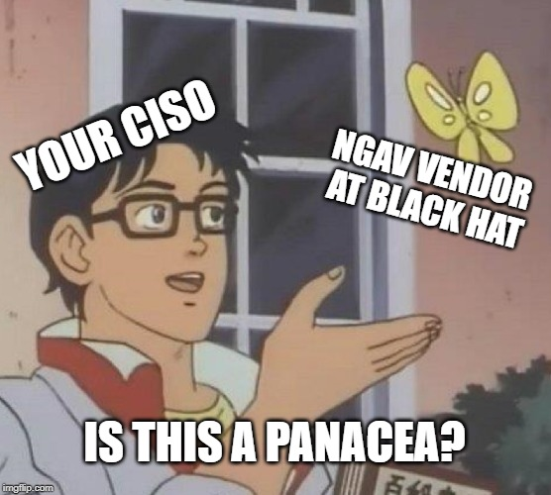
Understanding risk and opportunity
Thinking ahead sometimes means
STOP buying solutions
START solving problems
Notes:
Too often we fall into the trap of poorly “outsourcing” problem solving to the nearest available vendor. That’s not always the best use of budget, and sometimes straight-up detrimental to the resulting security posture of your systems

Slide 18
The 4 Follies of the Breachable Enterprise™
Poor patching discipline
Problem and solution usually aren’t technical…
Too many local admins
Makes end-user attacks and persistence way more effective
Too many domain admins
Increased likelihood of Domain Domination without notice
No application control
Are your users better fit to assess the risk of application installs?
Notes:
This isn’t news, these are all repeat offenders - want to know what the seemingly biggest hurdles of basic IT Security management Anno 2019 look like? Just google for “biggest hurdles of basic IT Security management 2009”

Slide 19
Things you can do without a huge budget
Event forwarding! No budget for splunk? No worries, WEF + ELK!
(Check out “WEF – A Palantir in your hands” @Arcontar)
Enable AppLocker in Audit Mode
Start with default rules – tune in small iterations
Capture autoruns and browser extensions on startup or logon
Deploy Sysmon
Start small, test new rules in small iterations
Review and deploy baseline configurations
Notes:
The 3 rules of Performance optimatizations can be summarized as “Measure, Measure and Measure”.
For defensive security, the equivalent first rule is to ensure you have the visibility into what’s going on on your endpoints. Plenty of free(!!!) components exist to enable you to forward large swaths of telemetry from your Windows endpoints – so prioritize setting up the infrastructure to forward and analyse event log data if you haven’t already.
List is obviously non-exhaustive – additional actions include: upgrading PowerShell/WMF to 5.1 everywhere, Admin account segregation in Active Directory etc.

Slide 20
Local Admin Temporary Elevation Request
L.A.T.E.R
Notes:
Who doesn’t love a good backronym?

Slide 21
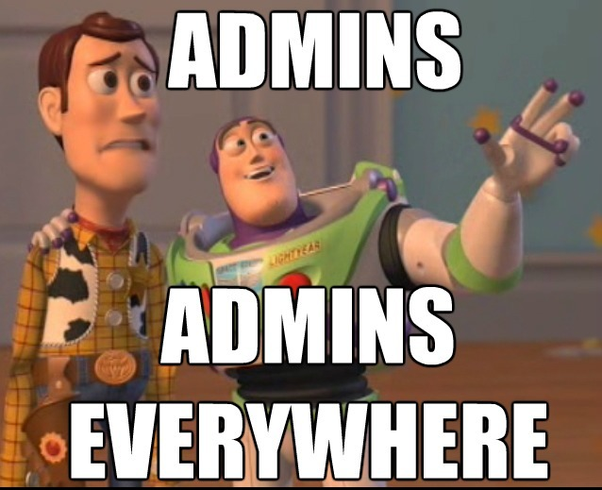
Local Admin Temporary Elevation Request
The problem:
- Many users with local admin privs
For an attacker – this is gold!
… but it gets worse:
- Many through shared groups in AD
- “Local Admins – Department X”
- “Local Admins – Office Y”
Notes:
Sharing privilege assignments across many users is a terrible thing. If I pwn one laptop I’ve now pwned 200!

Slide 22
The Classic Conversation
“We need fewer local admins”
“Alright, let me find the cheapest solution”
“You can’t have budget for that”
“Okay, I’ll just take it away from everyone via GPO”
“WHAT ARE YOU DOING NOBODY CAN WORK!?!??!??!! YOU’RE FIRED!”
Notes:
So what usually plays out when you attempt to enforce things like Restricted Groups for the builtin Administrators group across your fleet

Slide 23
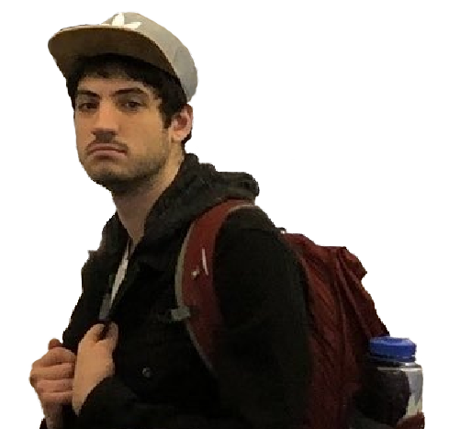

The immediate result?
Helpdesk handing out LAPS passwords
Terrible user experience – how does 90#1aBQQ$F90M*Kwa sound?
Hard time correlating local admin actions with helpdesk tickets
Notes:
… not what we had in mind

Slide 24


The Solution
Log request
Active Directory
(All the LAPS)
Throttle
Windows Server
w/PowerShell
Fetch Password
Request LAPS password
Return Password
Force GPUpdate
Make NT AUTHORITY\INTERACTIVE
local admin
Verify request
($PSSenderInfo)
Expire LAPS password
Notes:
Pair with Restricted Groups + disable RDP and Remote Assistance, and you now have a sort of “self-healing” temporary assignment that only works for the console session on the machine!
The time it takes to revert is entirely dependent on the Group Policy client-side refresh interval (defaults to 90 minutes, which is probably an acceptable window for most orgs)

Slide 25
The Result?
Near-zero burden on helpdesk
Users are happy - just 1 click and a few seconds and their admin
Without having to log back in!
Events are easy to correlate
Attack surface reduction: User is not admin, INTERACTIVE is
No admin privs for network logins

Slide 26
Components?
PowerShell script with a simple WPF GUI – literally one button
Can be packaged in SCCM/Intune or pushed with GPO
Constrained endpoint configuration for retrieval + accounting
Account with read-access to LAPS in the appropriate subtree
A database (MSDE will do) or a queue (like Redis, RabbitMQ)
Notes:
As long as you log the attempts to the event log, a log file or your SIEM, the last part is optional, although _highly_ recommended in order to throttle excessive requests

Slide 27
NoNeedToCry – $0 Ransomware Mitigation
75 B.C.
- Julius Caesar is held for ransom by Cilician pirates in the Aegean Sea
1938
- The Royal Navy buys Bletchley Park, MI6 invents modern cryptography
1989
- World Wide Web becomes tangible, widespread internet adoption ensue
2015
- Your corporate printer is held ransom by a North Korean bitcoin miner
Notes:
A brief history of Ransomware…

Slide 28
NoNeedToCry – $0 Ransomware Mitigation
Spring 2015
- Ransomware infections are a weekly occurrence
- We spend ~50-120 hours/incident (contain/clean/restore/retro)
- Lost productivity on the floor
- No one in IT Support or Security actually gets anything done
Notes:
Ransomware exploded in proliferation in 2015 and it hurt – not in terms of data loss (remember to test your backups!), but in terms of lost productivity!

Slide 29
NoNeedToCry – $0 Ransomware Mitigation
“I have an idea!
What if we force the attackers to waste their time on systems that have no value?”
- Ben
Notes:
OK, maybe my colleague Ben didn’t say exactly that, but this was all I heard!

Slide 30
NoNeedToCry – $0 Ransomware Mitigation
The System:
1 Windows File server with 100K dummy files (.jpg, .docx, .xlsx, etc…)
Detailed File Share auditing turned on
auditpol /set /subcategory:"Detailed File Share" /success:enable
File Event monitoring trigger on ownership change or file write events:
Disable owning account in AD
Disable computer account in AD
Page on-call
Got EDR orchestration in place? Trigger automatic triage + containment
Notes:
Ransomware honeypots are easier to built than you think!

Slide 31
NoNeedToCry – $0 Ransomware Mitigation
The Path:
Most ransomware enumerate mounted volumes via WMI or diskpart
The APIs always return the volumes in alphabetical order
Is anyone using 2 floppy/diskette drives in 2015?
We’ll mount on B:
Notes:
Our insistence on analyzing the malware and reviewing our incident response process allowed us to glean the insights required to shape attacker behavior

Slide 32
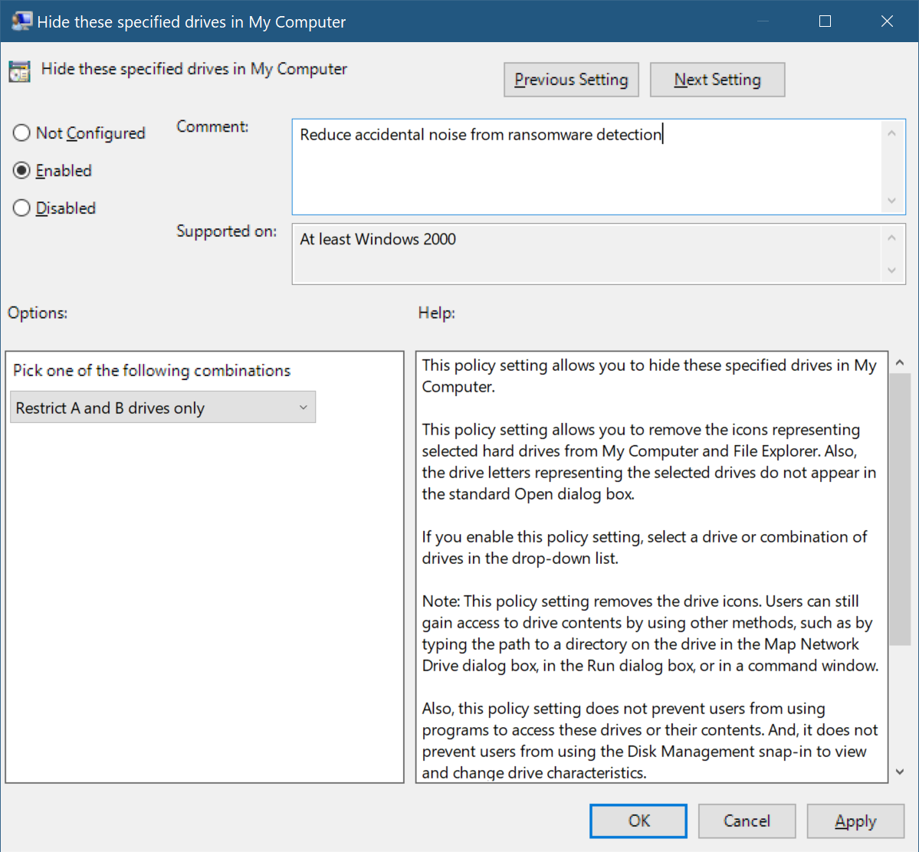
NoNeedToCry – $0 Ransomware Mitigation
The final touch
Hiding in plain sight!
Notes:
Having curious users click around your new mounted ransomware honey share can create some false positives – hide it from Explorer and the curious users be gone!

Slide 33
Summary
Engage with empathy
Become an enabler
Understanding > products
PowerShell is immensely helpful for security delegation
Notes:
Sum up your key messages

Slide 34
Notes:
[REQUIRED SLIDE]
Make sure you provide all materials that audience needs to reproduce your demos.
Either upload them as a PowerShell module to www.powershellgallery.com (preferred for reusable functions)
Or, upload them to our github repository (ask the girls at the info desk to provide you with access)
Or, upload them to your own github repository
Please make sure all materials are available by the time your presentation starts, or at minimum upload them right after your presentation

Slide 35
Notes:
[REQUIRED SLIDE]
If you sticked to your timing, you now have 15 min left for Q&A. If you missed your timing, you will have to leave the room when your slot is over. In this case, invite your audience to the coffee break and offer to cover questions there.
IN ANY CASE please point your audience to the conference app and the session voting. By the time the conference opens, the eventraft app *should* have the option to vote on sessions.
Please MAKE SURE you leave your room when your slot is over. The next speaker would like to set him/herself up and get everything up and running.

Slide 36
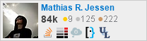
about_Speaker
Mathias R. Jessen (@IISResetMe)
Professionally
Threat Detection Engineer @ Booking.com (we’re hiring!)
Reads a lot of code, writes very little
Recovering {web dev, ops-person, heckler}
Privately
Obsessed with PowerShell
Addicted to
StackExchange
Black (?:Liquorice|Metal)

